Slide 1
Dog Programming Language
第19組
許力仁、趙哲宏、郭家佑、吳元智

Slide 2
OutLine
歷史
特性
語法
範例

Slide 3
歷史

Slide 4
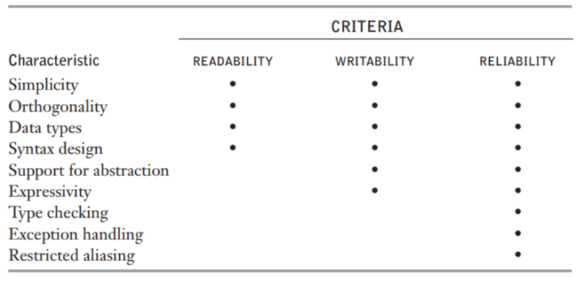
特性

Slide 5
特性
•直觀
•指令簡單、少
•不用花很多時間做學習
•需要網路上特殊的compiler
•多半依靠數學的計算

Slide 6
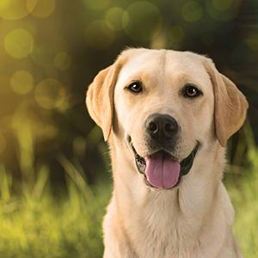
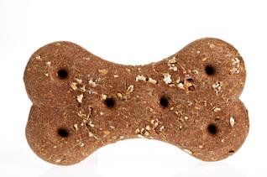
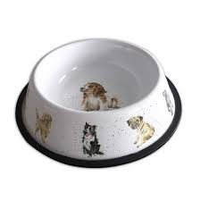

語法

Slide 7
語法--dishX
the command is executed however many cookies is in that dishX

Slide 8
語法--plateX
the command is only executed once if the number of cookies on the plateX is not 0

Slide 9
語法--floor
the dog will choose a random number from the floor that isn't 0

Slide 10
語法--command
fetch X - Place X cookies into dog's mouth, adding onto whatever number is already there.
drop V - Move cookies from dog's mouth into V, adding onto whatever number is already there.
pickup V - Move cookies from V to dog's mouth, adding onto whatever number is already there.
eat [X] - Subtract X amount of cookies from dog's mouth. If X isn't provided, dog eats all cookies.

Slide 11
語法--command
clear V - Resets V to 0. If V is floor, it resets the entire floor to 0.
die - Ends the program. Dog dies. :(
take - Waits for user to input a number and adds that number to the dog's mouth.
show - Prints the number that is in the dog's mouth.
give - Prints the number that is in the dog's mouth and resets dog's mouth to 0.

Slide 12
語法--command
bark "string" - Prints whatever is in the quotes to the screen. Use \n to print a newline.
jump label_name - Jumps to the label label_name.
label label_name - Where a jump command jumps to when jumping to the label "label_name".

Slide 13
範例

